Slide 1








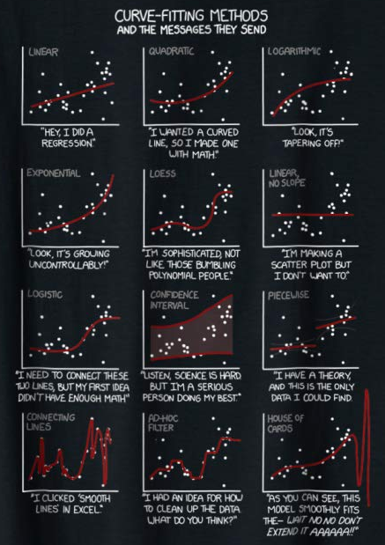


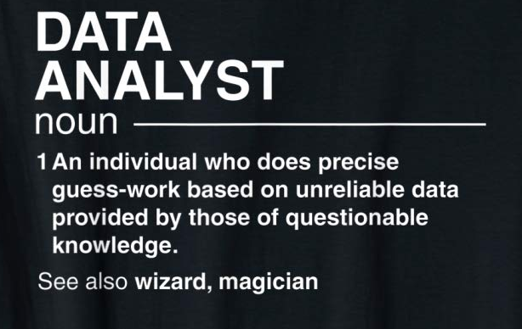
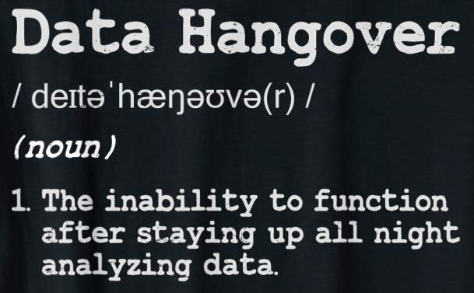


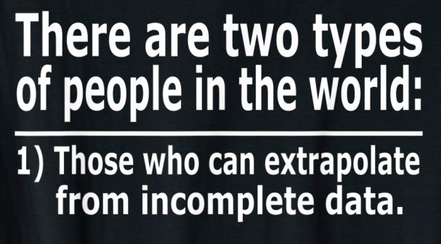









Slide 2
14
:
0
1
2
3
4
5
0
1
2
3
4
5
6
7
8
9
0
1
2
3
4
5
6
7
8
9
0
1
2
3
4
5
6
7
8
9
0
1
2
3
4
5
6
7
8
9
0
1
2
3
4
5
6
7
8
9
0
1
2
3
4
5
6
7
8
9

Slide 3
13
:
0
1
2
3
4
5
0
1
2
3
4
5
6
7
8
9
0
1
2
3
4
5
6
7
8
9
0
1
2
3
4
5
6
7
8
9
0
1
2
3
4
5
6
7
8
9
0
1
2
3
4
5
6
7
8
9
0
1
2
3
4
5
6
7
8
9

Slide 4
12
:
0
1
2
3
4
5
0
1
2
3
4
5
6
7
8
9
0
1
2
3
4
5
6
7
8
9
0
1
2
3
4
5
6
7
8
9
0
1
2
3
4
5
6
7
8
9
0
1
2
3
4
5
6
7
8
9
0
1
2
3
4
5
6
7
8
9

Slide 5
11
:
0
1
2
3
4
5
0
1
2
3
4
5
6
7
8
9
0
1
2
3
4
5
6
7
8
9
0
1
2
3
4
5
6
7
8
9
0
1
2
3
4
5
6
7
8
9
0
1
2
3
4
5
6
7
8
9
0
1
2
3
4
5
6
7
8
9

Slide 6
10
:
0
1
2
3
4
5
0
1
2
3
4
5
6
7
8
9
0
1
2
3
4
5
6
7
8
9
0
1
2
3
4
5
6
7
8
9
0
1
2
3
4
5
6
7
8
9
0
1
2
3
4
5
6
7
8
9
0
1
2
3
4
5
6
7
8
9

Slide 7
9
:
0
1
2
3
4
5
0
1
2
3
4
5
6
7
8
9
0
1
2
3
4
5
6
7
8
9
0
1
2
3
4
5
6
7
8
9
0
1
2
3
4
5
6
7
8
9
0
1
2
3
4
5
6
7
8
9
0
1
2
3
4
5
6
7
8
9

Slide 8
8
:
0
1
2
3
4
5
0
1
2
3
4
5
6
7
8
9
0
1
2
3
4
5
6
7
8
9
0
1
2
3
4
5
6
7
8
9
0
1
2
3
4
5
6
7
8
9
0
1
2
3
4
5
6
7
8
9
0
1
2
3
4
5
6
7
8
9

Slide 9
7
:
0
1
2
3
4
5
0
1
2
3
4
5
6
7
8
9
0
1
2
3
4
5
6
7
8
9
0
1
2
3
4
5
6
7
8
9
0
1
2
3
4
5
6
7
8
9
0
1
2
3
4
5
6
7
8
9
0
1
2
3
4
5
6
7
8
9

Slide 10
6
:
0
1
2
3
4
5
0
1
2
3
4
5
6
7
8
9
0
1
2
3
4
5
6
7
8
9
0
1
2
3
4
5
6
7
8
9
0
1
2
3
4
5
6
7
8
9
0
1
2
3
4
5
6
7
8
9
0
1
2
3
4
5
6
7
8
9

Slide 11
5
:
0
1
2
3
4
5
0
1
2
3
4
5
6
7
8
9
0
1
2
3
4
5
6
7
8
9
0
1
2
3
4
5
6
7
8
9
0
1
2
3
4
5
6
7
8
9
0
1
2
3
4
5
6
7
8
9
0
1
2
3
4
5
6
7
8
9

Slide 12
4
:
0
1
2
3
4
5
0
1
2
3
4
5
6
7
8
9
0
1
2
3
4
5
6
7
8
9
0
1
2
3
4
5
6
7
8
9
0
1
2
3
4
5
6
7
8
9
0
1
2
3
4
5
6
7
8
9
0
1
2
3
4
5
6
7
8
9

Slide 13
3
:
0
1
2
3
4
5
0
1
2
3
4
5
6
7
8
9
0
1
2
3
4
5
6
7
8
9
0
1
2
3
4
5
6
7
8
9
0
1
2
3
4
5
6
7
8
9
0
1
2
3
4
5
6
7
8
9
0
1
2
3
4
5
6
7
8
9

Slide 14
2
:
0
1
2
3
4
5
0
1
2
3
4
5
6
7
8
9
0
1
2
3
4
5
6
7
8
9
0
1
2
3
4
5
6
7
8
9
0
1
2
3
4
5
6
7
8
9
0
1
2
3
4
5
6
7
8
9
0
1
2
3
4
5
6
7
8
9

Slide 15
1
:
0
1
2
3
4
5
0
1
2
3
4
5
6
7
8
9
0
1
2
3
4
5
6
7
8
9
0
1
2
3
4
5
6
7
8
9
0
1
2
3
4
5
6
7
8
9
0
1
2
3
4
5
6
7
8
9
0
1
2
3
4
5
6
7
8
9

Slide 16
Let’s Go!
0
:
0
1
2
3
4
5
0
1
2
3
4
5
6
7
8
9
0
1
2
3
4
5
6
7
8
9
0
1
2
3
4
5
6
7
8
9
0
1
2
3
4
5
6
7
8
9
0
1
2
3
4
5
6
7
8
9
0
1
2
3
4
5
6
7
8
9

Slide 17
AFS 2023 – Grand Rapids
Introductory GIS for Fisheries Biologists
Advanced GIS for Fisheries Biologists
Bayesian I: Introductory Bayesian Inference with JAGS for Fish Biologists
Bayesian II: Intermediate Bayesian Inference with JAGS for Fish Biologists
Data Wrangling using the Tidyverse in R
How To Run Citizen Science Projects with Anglers
Scientific Writing Workshop
Aquatic Plant Identification
Informing Fisheries Management with Individual-Based Models in R

Slide 18
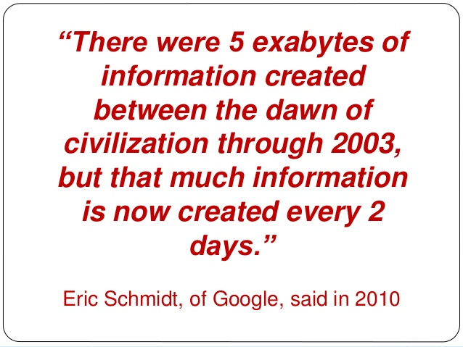
Notes:
5 exabytes = 5 billion gigabytes
Standard computer is 500 GB
That’s 10M computers…or a stack of hard drives that would reach the Internation Space Station

Slide 19
“Over the last two years alone 90 percent of the data in the world was generated”
-Forbes 2018

Slide 20
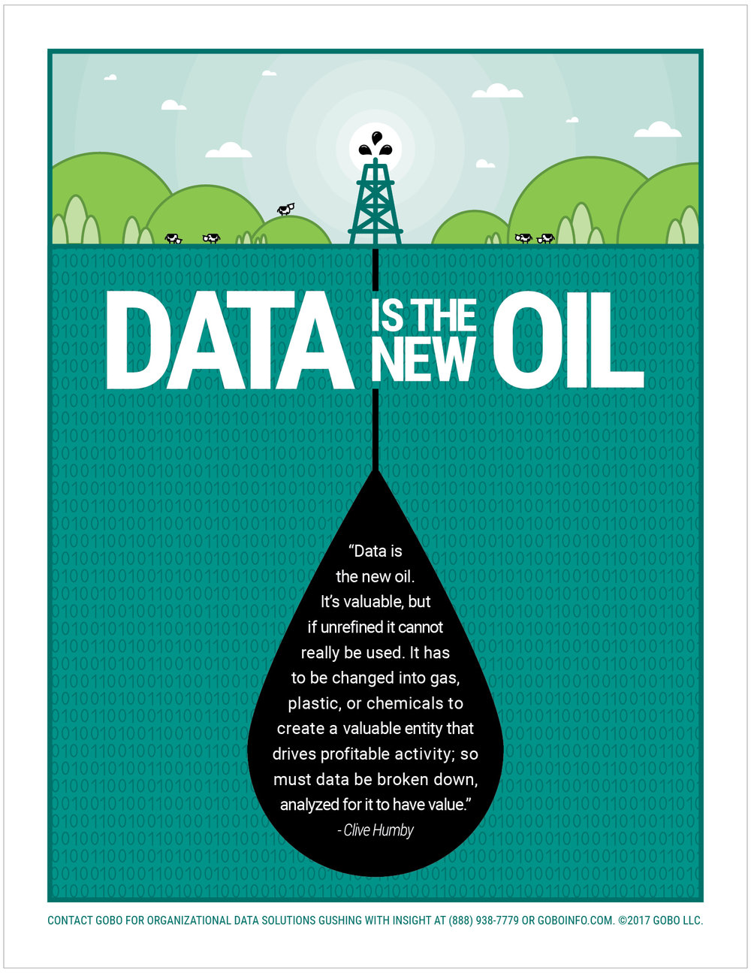

Slide 21


Slide 22
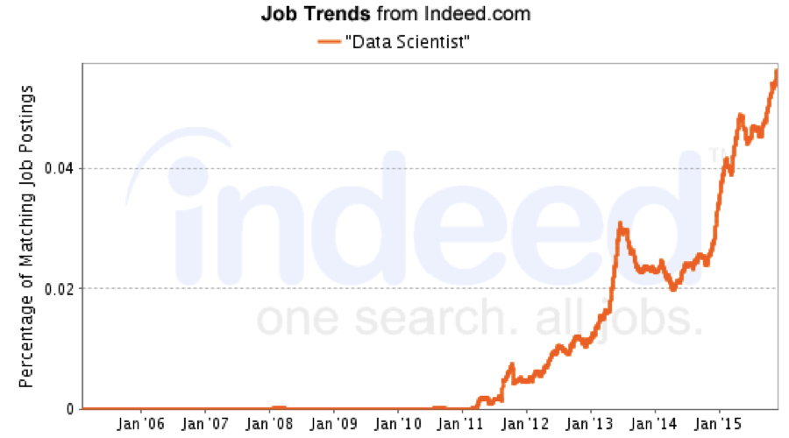

Slide 23
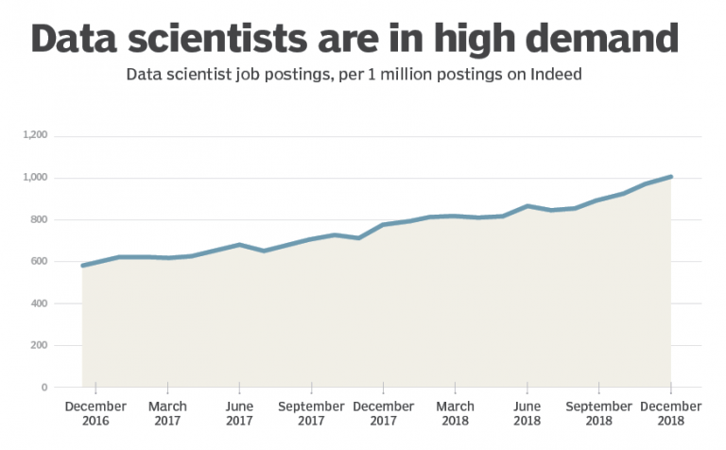

Slide 24


Slide 25
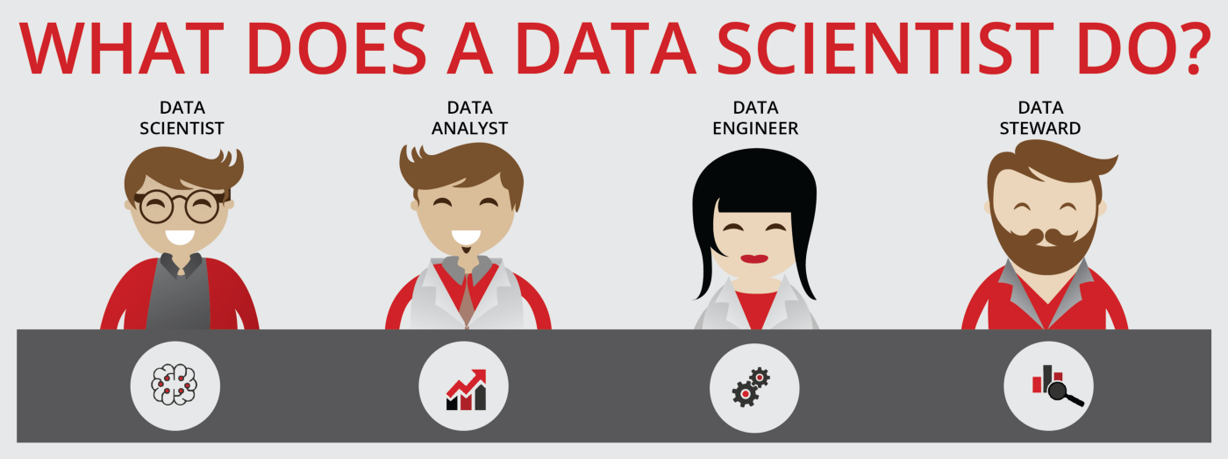

Slide 26


Slide 27
AI
Data Producer
Machine Learning
Data Scientist
Data Manager
DBA
Do Something
Predict Something
Learn Something
Store Something
Measure Something

Slide 29
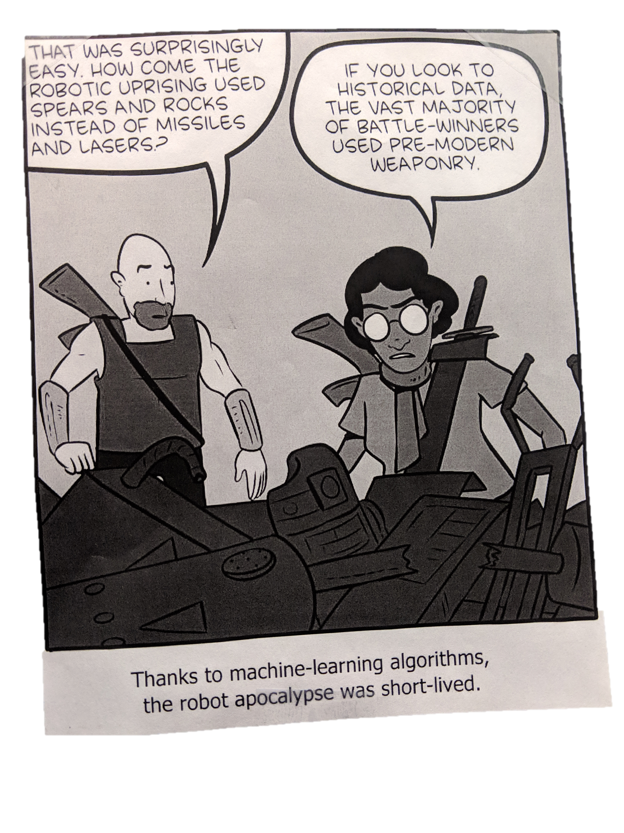

Slide 30
“The industries that use ML are slowly learning that the data used to train ML systems must be as unbiased and trusted as the systems themselves need to be…”
MIT Task Force on the Work of the Future, 2019

Slide 31
“… analytic projects fail when the data quality is inferior. Bad data creates poor results.”
4 Reasons Data Analytics Often Fail
www.governing.com
Notes:
Second, analytic projects fail when the data quality is inferior. Bad data creates poor results. Lack of data sharing can also hobble the best planned analytics project. While there are technical barriers to data sharing, too often the problem is an unwillingness to share between agencies or departments. The result is turf battles that erupt when one agency wants to protect the data they’ve collected.

Slide 32
AI
Data Producer
Machine Learning
Data Scientist
Data Manager
DBA
Do Something
Predict Something
Learn Something
Store Something
Measure Something

Slide 33
AI
Data Producer
Machine Learning
Data Scientist
Data Manager
DBA
Do Something
Predict Something
Learn Something
Store Something
Measure Something

Slide 34


Slide 35

Name
Affiliation
Show Me The Data!
Share The Shame

Slide 36




Slide 37

Care
And
Feeding
Of The
Data
Monster

Slide 38


Slide 39
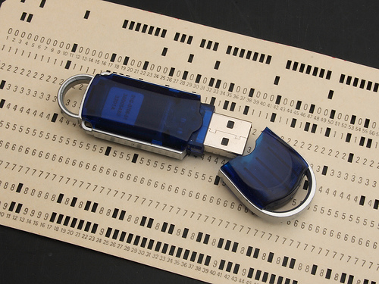
Notes:
Computing Resources have come a long ways.
GUI’s change, but underlying data is universal

Slide 40


Slide 41
What are data skills?

Slide 42
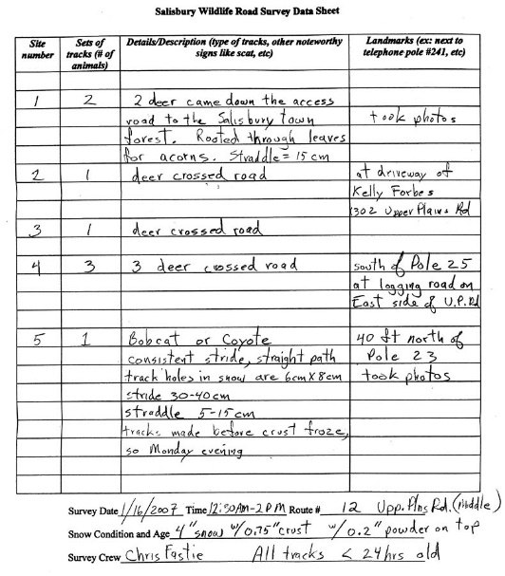

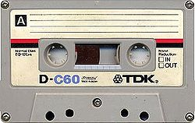
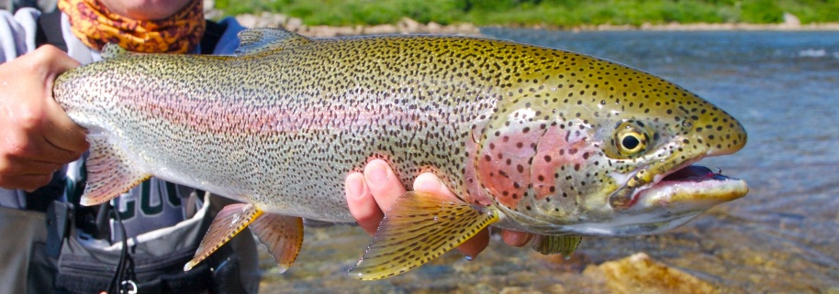

What is data?

Slide 43
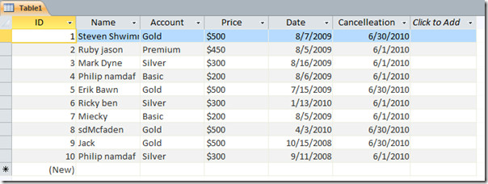
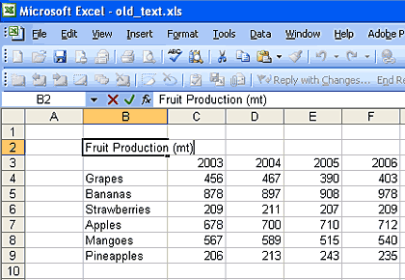

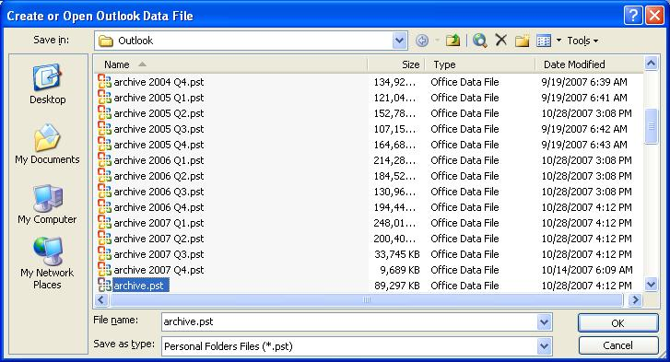
What is a datastore?

Slide 44
What is a database?

Slide 45


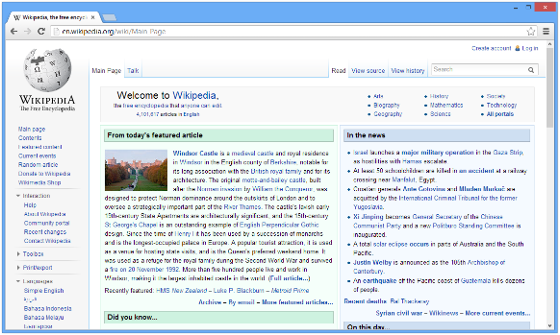

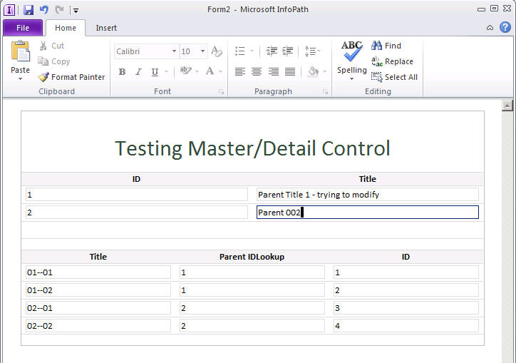



What is a data system?

Slide 46
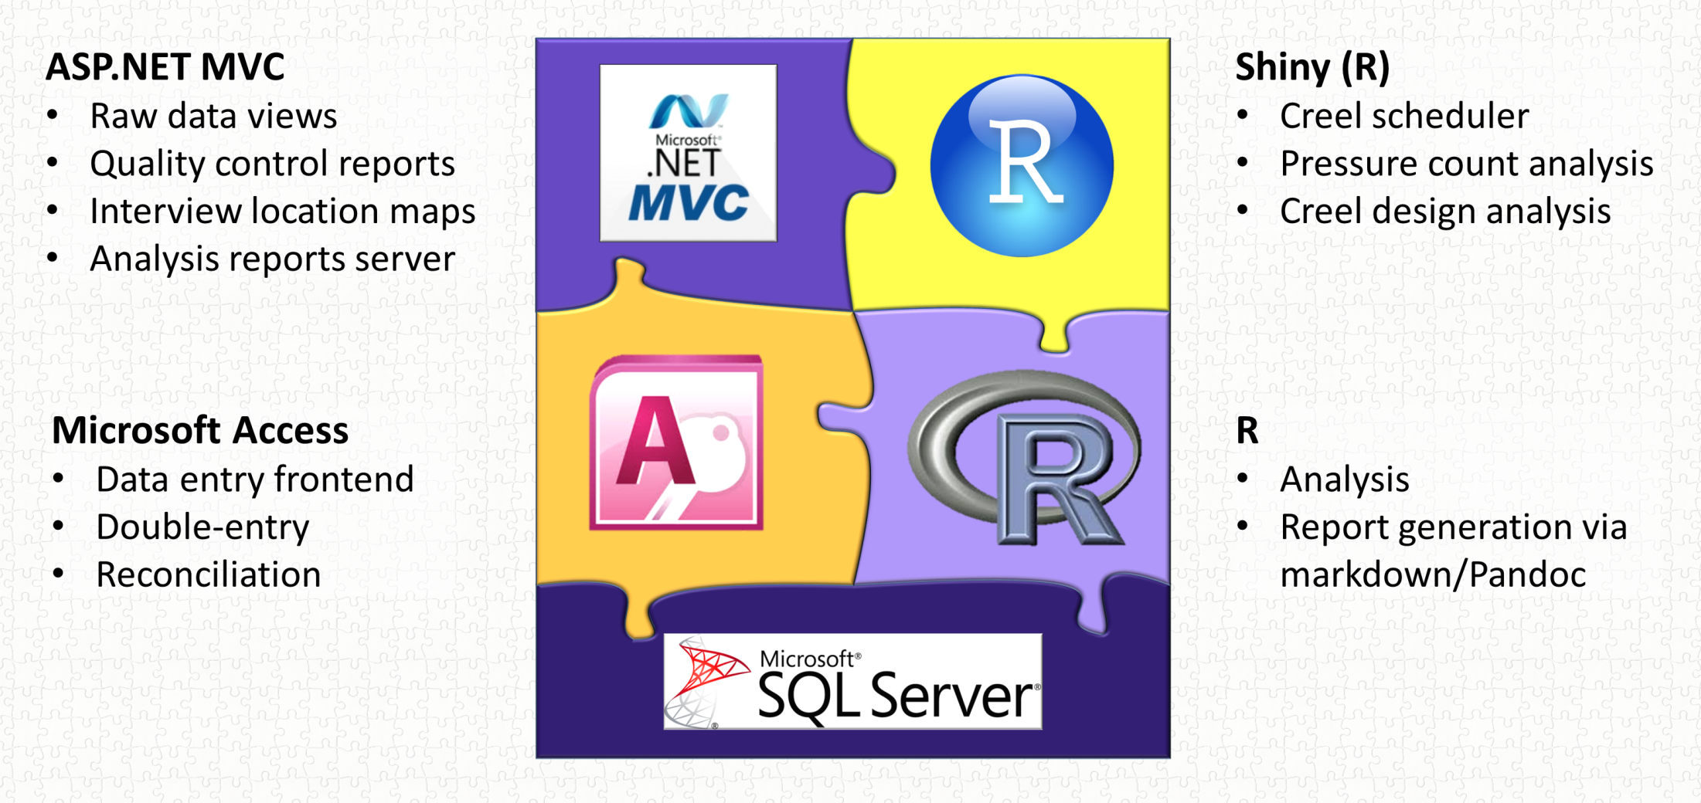
What is a data system?

Slide 47



Slide 48
Data Management
Data Tools
Designing A Relational Database
Using Microsoft Access

Slide 49

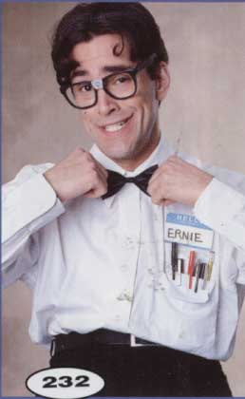
Welcome
To The World
Of The Geek
Data
Management
Notes:
Actually…normally more reminiscent of engineers than geeks. There’s always some truth to all stereotypes, so what about the geek represents good qualities of data managers?
Retentive nature, same way-every time, accept menial repetitive tasks as the cost of business…..
This gives us a nice framework for thinking about data management.

Slide 50
Why is data management important to me?
Save Time!
Save Money!
No data…….no money
No data……no thesis
No data……no publications
Set yourself apart

Slide 51

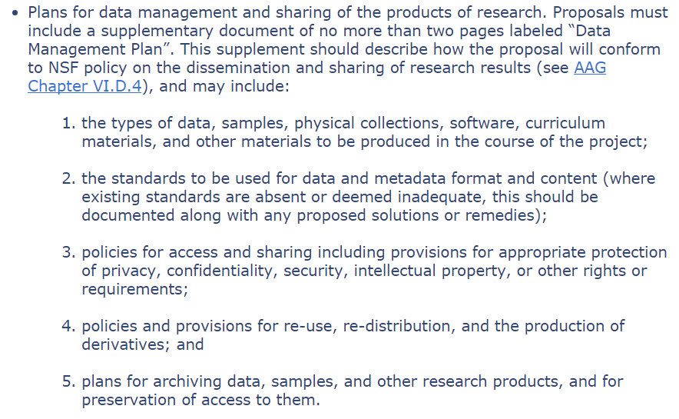

Slide 52
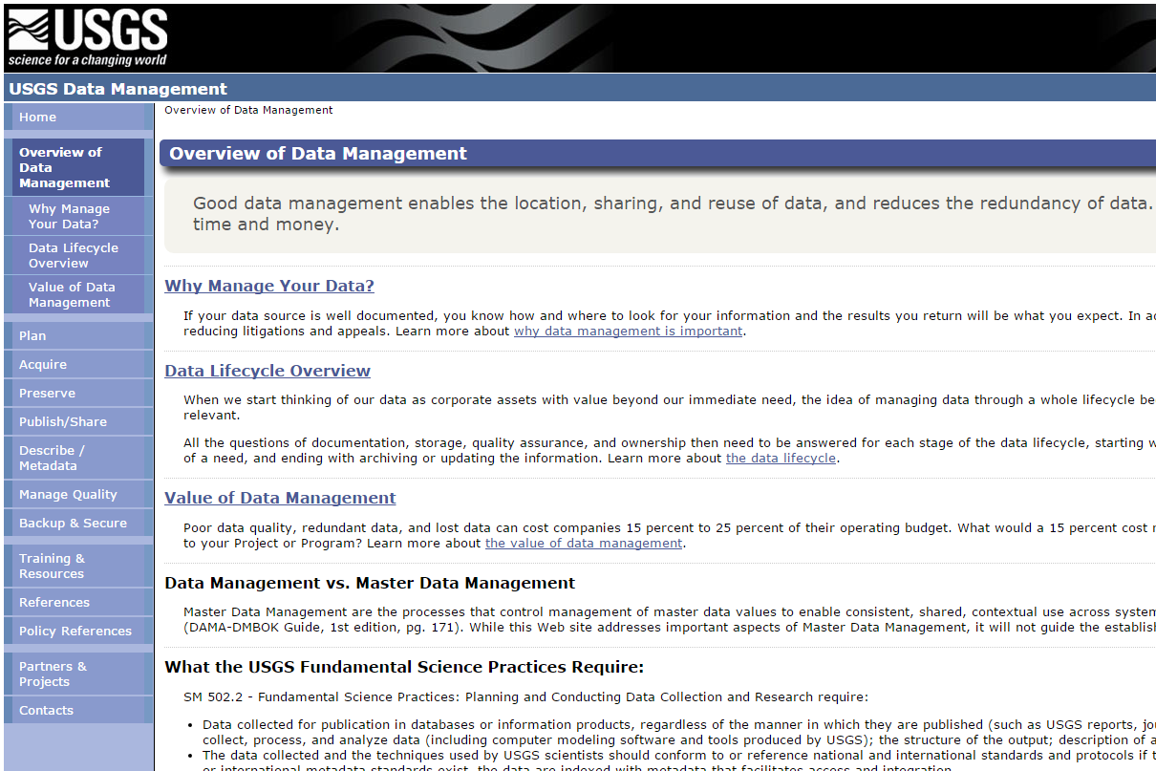

Slide 53
Data Management
"Data Resource Management is the development and execution of architectures, policies, practices and procedures that properly manage the full data lifecycle needs of an enterprise.“
– DAMA International

Slide 54
Data Management
“Use of policies and procedures to protect and efficiently use information.“
– Keith Hurley

Slide 55
Data Management
“Use of policies and procedures to protect and efficiently use information.“
– Keith Hurley

Slide 56


Slide 57

Consistency
Detail
Redundancy
Notes:
Actually…normally more reminiscent of engineers than geeks. There’s always some truth to all stereotypes, so what about the geek represents good qualities of data managers?
Retentive nature, same way-every time, accept menial repetitive tasks as the cost of business…..
This gives us a nice framework for thinking about data management.

Slide 58
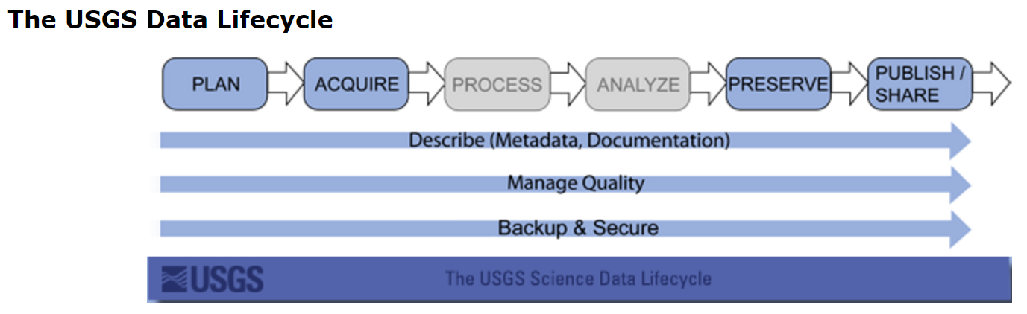
Data Lifecycle

Slide 59






Data Lifecycle
Field/Lab
Data Entry
Active/Analysis
Archive

Slide 60
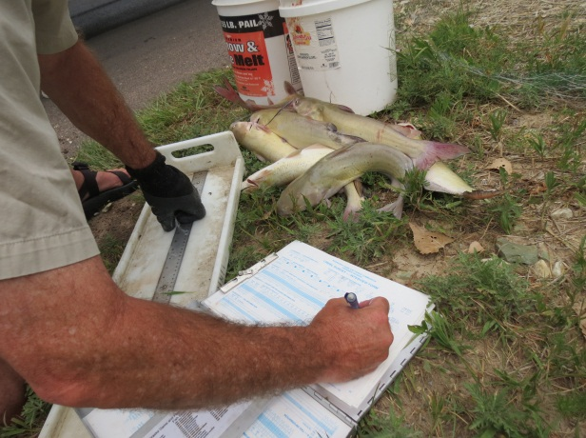
Field/Lab
Notes:
Layout
Units
Conversions/Codes
Waterproof
Self-explanitory
Visual Cues For Necessary Information
Methods to detect missing samples

Slide 61
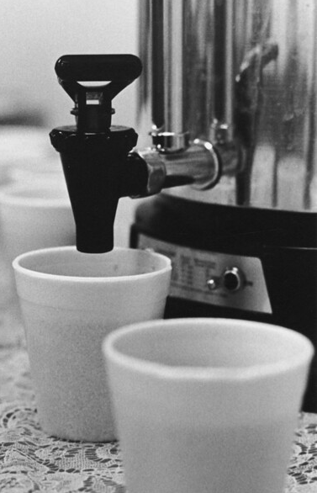
Break
15 Minutes
10 Minutes
5 Minutes

Slide 62
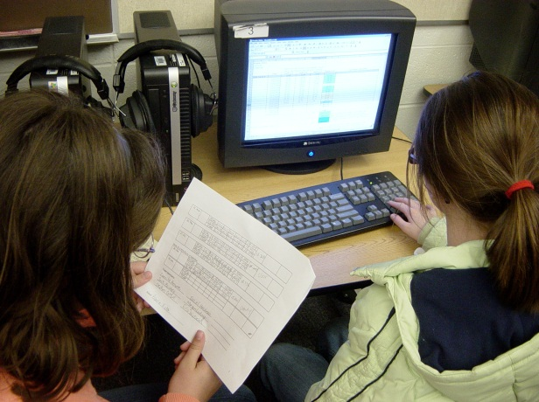
Data Entry
Notes:
Detect entry errors
Validation
Backup
Speed

Slide 63
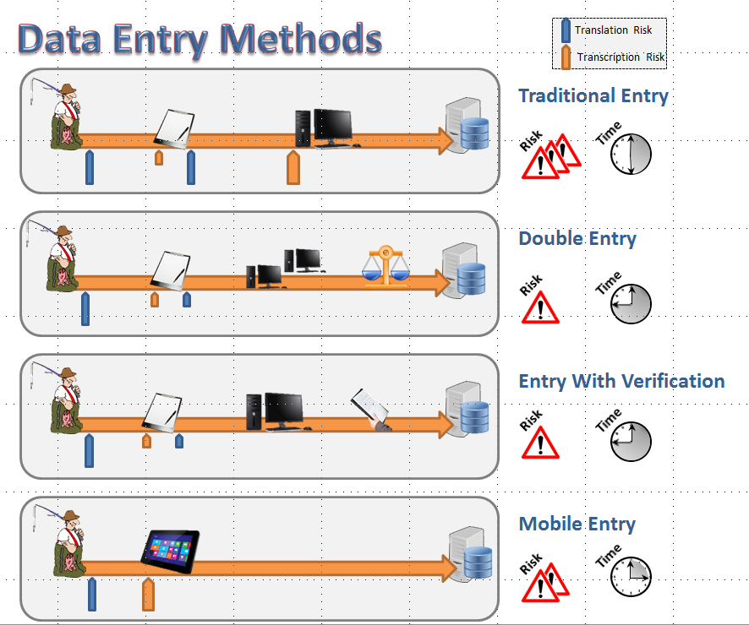
Notes:
Detect entry errors
Validation
Backup
Speed

Slide 64
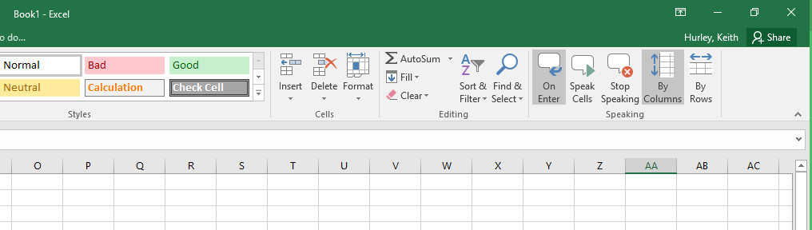

Slide 65
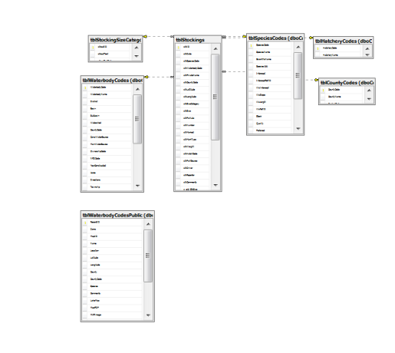
Active / Analysis

Slide 66
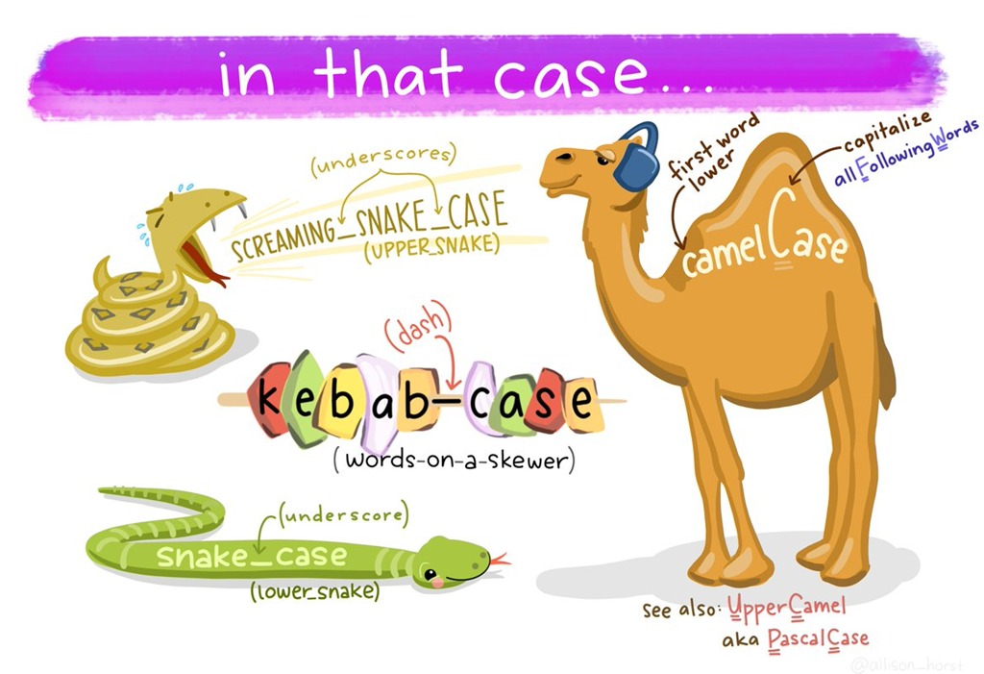

Slide 67

Archive
Notes:
Detect entry errors
Validation
Backup
Speed

Slide 68
Data Management
Field
Lab
Active/Analysis
Archive

Slide 69
Important Questions
Who can modify data?
Who can delete data?
Who can view data?
Who can use data?

Slide 70
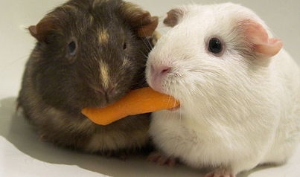
When data is available,
people WILL seek to use it!

Slide 71
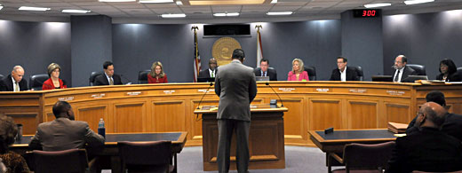

Slide 72
Break
15 Minutes
10 Minutes
5 Minutes

Slide 73






Databases
Notes:
Store and Retrieve Data
In our case tabular data

Slide 74




Notes:
Store and Retrieve Data
In our case tabular data

Slide 75




Slide 76

Flat Files

Slide 77

Flat Files
Spreadsheets

Slide 78
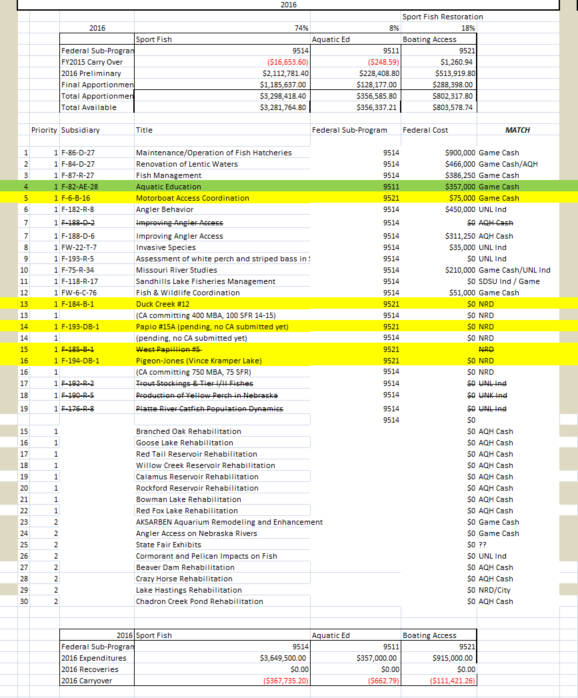
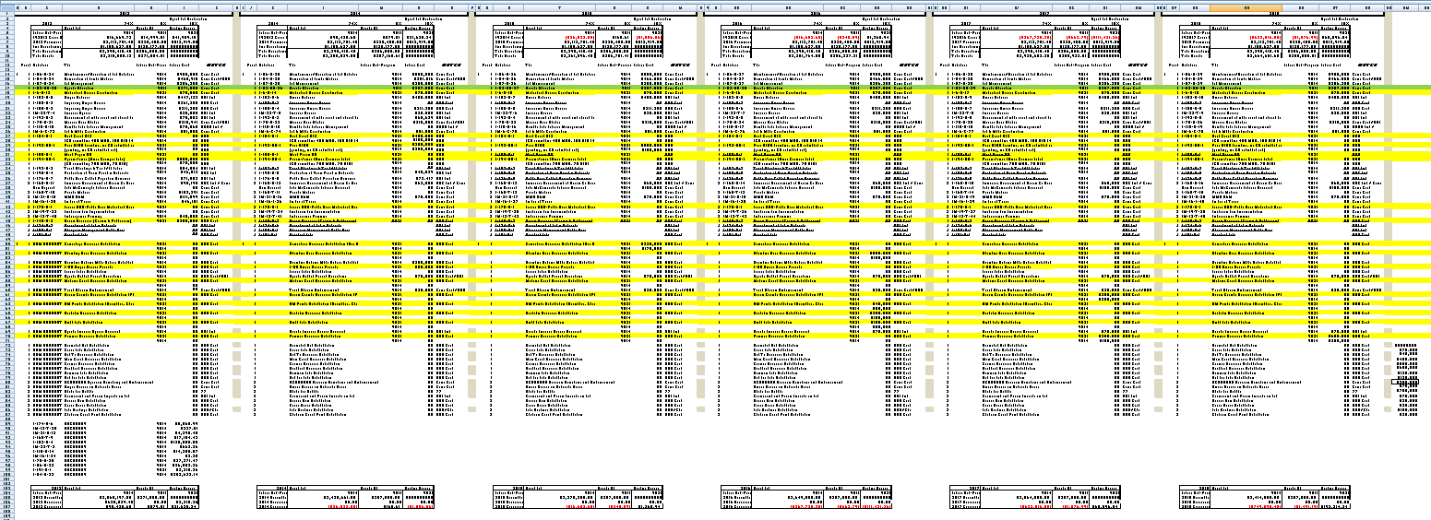

Slide 80


Slide 81


Slide 82
Do Not Use Spreadsheets

Slide 83

Flat Files
Spreadsheets
Statistical

Slide 84
Flat Files
Spreadsheets
Statistical
Non-Relational Databases

Slide 85



Flat Files
Spreadsheets
Statistical
Relational DB
Non-Relational Databases

Slide 86
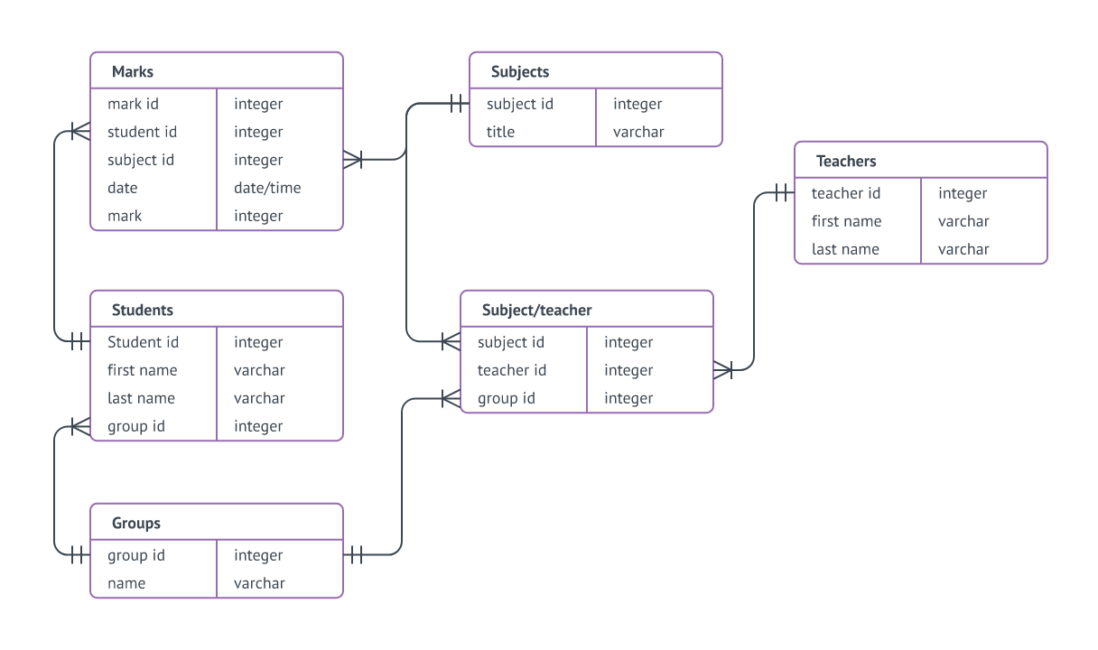
What is a relational database?
Notes:
Cascading updates and deletes to handle orphans and changes
Single point to change repeating values
Data has a “model” that relates to what it represents
Most are built around SQL language

Slide 87

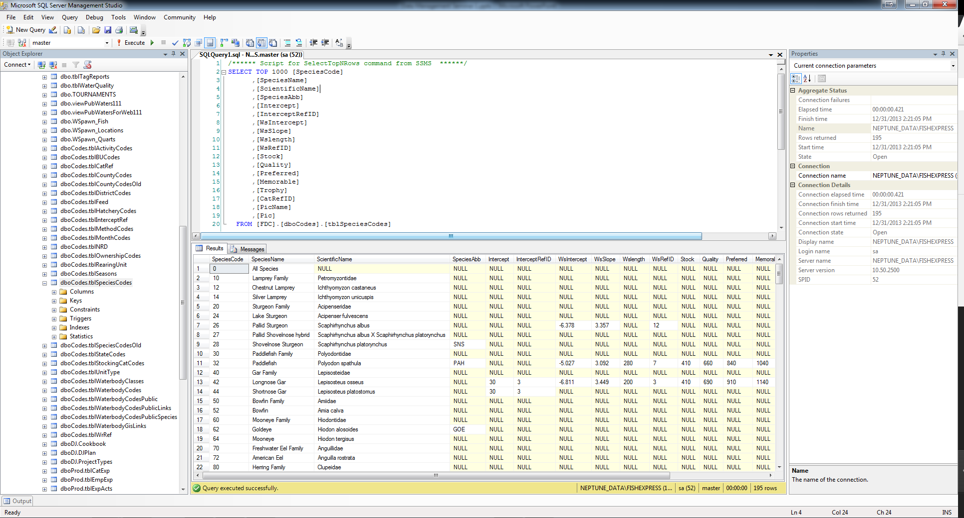
Stores Data
Runs Queries (Batch Operations)
Retrieves Data
Notes:
Can be on server or local computer
Mainly syntax (query) based
Views/Sprocs/Triggers
No real data entry capabilities
Only functional analysis capabilities

Slide 88
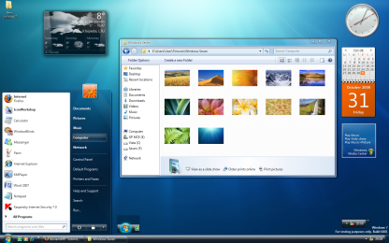
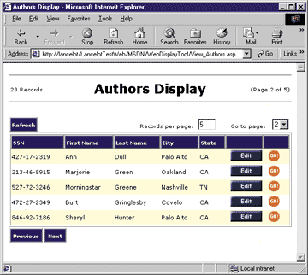
Stores Data
Runs Queries (Batch Operations)
Retrieves Data
Enter Data
Edit Data
Reports
Analysis
Enter Data
Edit Data
Reports
Analysis
Reports
Analysis

Slide 89

Tables
Queries
Forms
Forms
Reports
Reports
Notes:
What do you lose with access………views, stored procedures, triggers, multi-user issues

Slide 90
Enter Data
Edit Data
Reports
Analysis
Stores Data
Runs Queries (Batch Operations)
Retrieves Data
Reports
Analysis

Slide 91



Enter Data
Edit Data
Reports
Analysis
Reports
Analysis

Slide 92










Can I get you to develop a database? It will save me a ton of time, be
much easier, and do more.
No problem. It’ll cost a bucketload of money and take just three years to get done.
Forget it, we don’t have the resources. Just keep doing it like you always have. Oh, I also have something else I want you to do for me.
Fine, but I still have to find a way to get all this done. Access looks easy enough. Is that a good choice?
Not my problem. Stop bothering me.
TLDR
Guess I’ll do it myself!
Three Years Later
This database is really useful. I’m glad that I made it a priority! But you know what, it really should be online so others can use it.
I couldn’t agree more!
No problem. It’ll cost a bucketload of money and take just three years to get done.
I can’t live without this. Spend three bucketloads and get it to me in a year.
Wait, this is an Access database? Why did you set it up this way? These should be separate tables. Everything is a string data type? ARGGGGGHHH.
What? Well, I did the best I could. Would be nice if we had a department of people whose job was to help with these types of things.
We’ll have to start from scratch and do this the right way.
Will it have all my past data?
No, that’s impossible. You really should have talked to us about this.

Slide 93
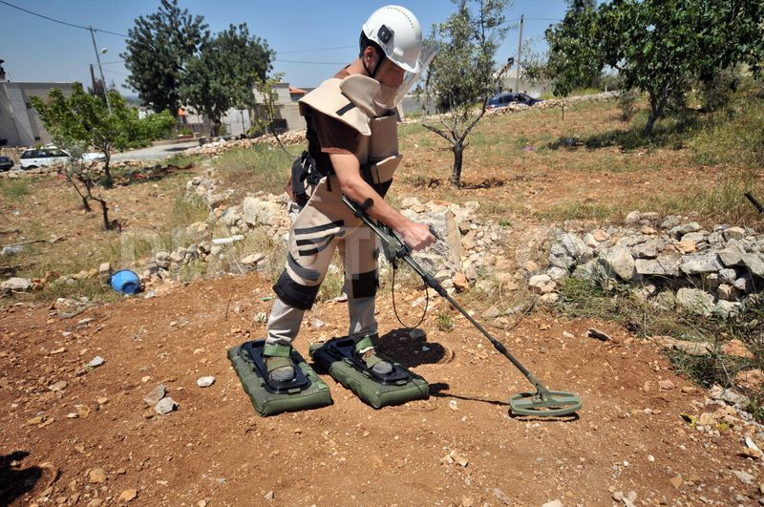
Why Does IT Hate MS Access?

Slide 94
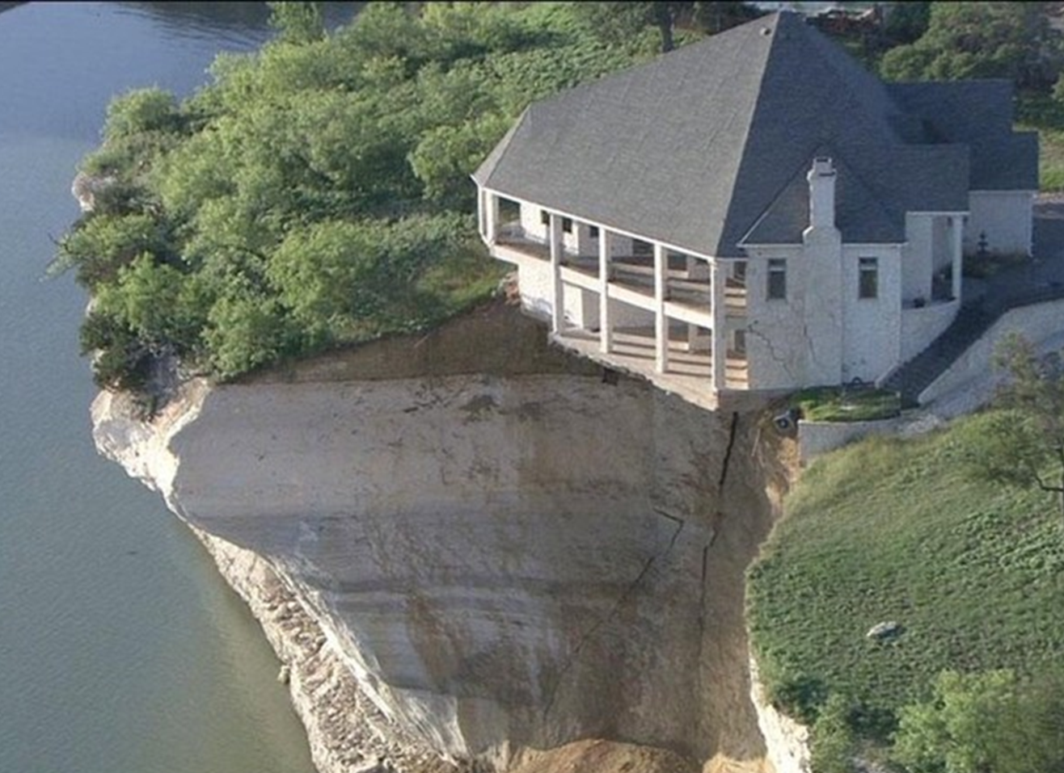
Designing
A
Database
Notes:
Use access to show how to design a database
Good design means
simpler queries
better performance
less data entry
easier to add data fields without breaking backwards compatibility
Think of records as an “entity”…and then “sets” of entities”

Slide 95

D’oh
Hurley’s Lessons Learned
Does history matter?
Delete or Deactivate?
Define the difference between null and zero
Every record gets its own identifier
Avoid text variables….PERIOD
Naming conventions

Slide 96
tblNets
tblFish
qryDates
net_UID
net_Date
net_Type
net_MeshSize
fsh_UID
fsh_netUID
fsh_Species
fsh_Length
fsh_Weight
net_UID
net_Date
fsh_UID
fsh_netUID
fsh_species

Slide 97
To Do
Create Lookup Tables To Remove Text
Split Out Sets Of Fields That Repeat Down Columns
Transpose columns to rows where possible
Goals
Each row represents one and only one piece of meaningful data
Each piece of data is in only one place
No data is in field headers
In production, you can add rows and not columns

Slide 98
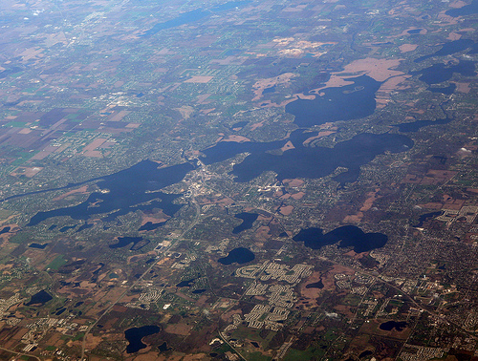
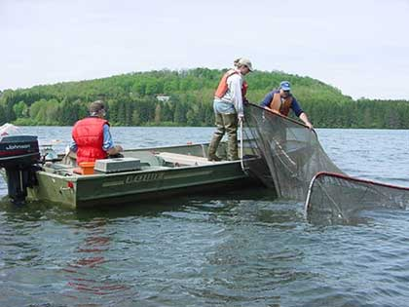
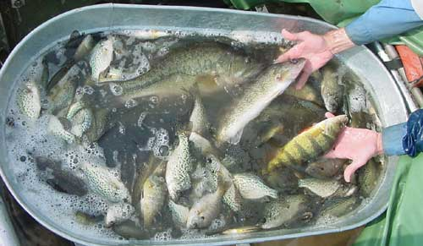
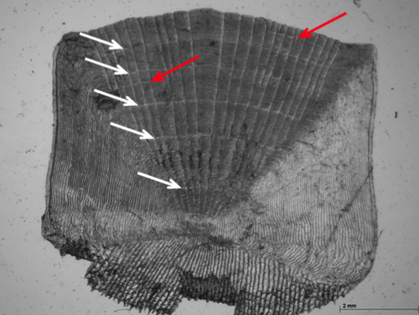
Notes:
Cascading updates and deletes to handle orphans and changes
Single point to change repeating values
Data has a “model” that relates to what it represents
Most are built around SQL language

Slide 99
date | lake | site | gear | species | length | weight | age | a1 | a2 | a3 | a4 | edge
06/01/13 | Round | Loon Point | Trap Net | bluegill | 210 | 254 | 4 | 178 | 223 | 381 | 413 | 413
06/01/13 | Round | Loon Point | Trap Net | bluegill | 243 | 222 | 4 | 145 | 242 | 335 | 481 | 490
06/01/13 | Round | Pintail Bay | Trap Net | bluegill | 135 | 86 | 2 | 195 | 284 |  |  | 292
06/01/13 | Round | West end of dam | Trap Net | redear | 142
06/25/13 | Round | Loon Point | Trap Net | black bullhead | 138
06/25/13 | Round | Pintail Bay | Trap Net | black bullhead | 179
06/25/13 | Round | Big Creek mouth | Trap Net | bluegill | 198 | 168 | 3 | 188 | 254 | 365 |  | 365
08/30/13 | Square | Mallard Cove | Gill Net | walleye | 854 | 355 | 4 | 113 | 241 | 384 | 476 | 484
08/30/13 | Square | Whitetail Point | Gill Net | walleye | 686 | 321 | 3 | 105 | 289 | 349 |  | 349
08/30/13 | Square | Bobber Bay | Gill Net | white bass | 312 | 211 |  |  |  |  |  | 230

Slide 100
date | lake | site | gear | species | length | weight | age | a1 | a2 | a3 | a4 | edge
06/01/13 | Round | Loon Point | 1 | 1 | 210 | 254 | 4 | 178 | 223 | 381 | 413 | 413
06/01/13 | Round | Loon Point | 1 | 1 | 243 | 222 | 4 | 145 | 242 | 335 | 481 | 490
06/01/13 | Round | Pintail Bay | 1 | 1 | 135 | 86 | 2 | 195 | 284 |  |  | 292
06/01/13 | Round | West end of dam | 1 | 2 | 142
06/25/13 | Round | Loon Point | 1 | 3 | 138
06/25/13 | Round | Pintail Bay | 1 | 3 | 179
06/25/13 | Round | Big Creek mouth | 1 | 1 | 198 | 168 | 3 | 188 | 254 | 365 |  | 365
08/30/13 | Square | Mallard Cove | 2 | 4 | 854 | 355 | 4 | 113 | 241 | 384 | 476 | 484
08/30/13 | Square | Whitetail Point | 2 | 4 | 686 | 321 | 3 | 105 | 289 | 349 |  | 349
08/30/13 | Square | Bobber Bay | 2 | 5 | 312 | 211 |  |  |  |  |  | 230
tblSpecies
spp_UID | spp_Name
1 | bluegill
2 | redear
3 | black bullhead
4 | walleye
5 | white bass
tblGears
gear_UID | gear_Name
1 | Trap Net
2 | Gill Net

Slide 101
date | site | gear | species | length | weight | age | a1 | a2 | a3 | a4 | edge
06/01/13 | 1 | 1 | 1 | 210 | 254 | 4 | 178 | 223 | 381 | 413 | 413
06/01/13 | 1 | 1 | 1 | 243 | 222 | 4 | 145 | 242 | 335 | 481 | 490
06/01/13 | 2 | 1 | 1 | 135 | 86 | 2 | 195 | 284 |  |  | 292
06/01/13 | 3 | 1 | 2 | 142
06/25/13 | 1 | 1 | 3 | 138
06/25/13 | 2 | 1 | 3 | 179
06/25/13 | 4 | 1 | 1 | 198 | 168 | 3 | 188 | 254 | 365 |  | 365
08/30/13 | 5 | 2 | 4 | 854 | 355 | 4 | 113 | 241 | 384 | 476 | 484
08/30/13 | 6 | 2 | 4 | 686 | 321 | 3 | 105 | 289 | 349 |  | 349
08/30/13 | 7 | 2 | 5 | 312 | 211 |  |  |  |  |  | 230
tblSites
site_UID | Site_lakeUID | site_Name
1 | 1 | Loon Point
2 | 1 | Pintail Bay
3 | 1 | West end of dam
4 | 1 | Big Creek mouth
5 | 2 | Mallard Cove
6 | 2 | Whitetail Point
7 | 2 | Bobber Bay
tblSpecies
spp_UID | spp_Name
1 | bluegill
2 | redear
3 | black bullhead
4 | walleye
5 | white bass
tblLakes
lake_UID | lake_Name
1 | Round
2 | Square
tblGears
gear_UID | gear_Name
1 | Trap Net
2 | Gill Net

Slide 102
date | site | gear | species | length | weight | age | a1 | a2 | a3 | a4 | edge
06/01/13 | 1 | 1 | 1 | 210 | 254 | 4 | 178 | 223 | 381 | 413 | 413
06/01/13 | 1 | 1 | 1 | 243 | 222 | 4 | 145 | 242 | 335 | 481 | 490
06/01/13 | 2 | 1 | 1 | 135 | 86 | 2 | 195 | 284 |  |  | 292
06/01/13 | 3 | 1 | 2 | 142
06/25/13 | 1 | 1 | 3 | 138
06/25/13 | 2 | 1 | 3 | 179
06/25/13 | 4 | 1 | 1 | 198 | 168 | 3 | 188 | 254 | 365 |  | 365
08/30/13 | 5 | 2 | 4 | 854 | 355 | 4 | 113 | 241 | 384 | 476 | 484
08/30/13 | 6 | 2 | 4 | 686 | 321 | 3 | 105 | 289 | 349 |  | 349
08/30/13 | 7 | 2 | 5 | 312 | 211 |  |  |  |  |  | 230

Slide 103
tblSets
set_UID | set_Date | set_Site | set_Gear
1 | 6/1/2013 | 1 | 1
2 | 6/1/2013 | 2 | 1
3 | 6/1/2013 | 3 | 1
4 | 6/25/2013 | 1 | 1
5 | 6/25/2013 | 2 | 1
6 | 6/25/2013 | 4 | 1
7 | 8/30/2013 | 5 | 2
8 | 8/30/2013 | 6 | 2
9 | 8/30/2013 | 7 | 2
tblFish
fish_UID | fish_setUID | fish_sppUID | fish_length | fish_weight | fish_age | a1 | a2 | a3 | a4 | edge
1 | 1 | 1 | 210 | 254 | 4 | 178 | 223 | 381 | 413 | 413
2 | 1 | 1 | 243 | 222 | 4 | 145 | 242 | 335 | 481 | 490
3 | 2 | 1 | 135 | 86 | 2 | 195 | 284 |  |  | 292
4 | 3 | 2 | 142
5 | 4 | 3 | 138
6 | 5 | 3 | 179
7 | 6 | 1 | 198 | 168 | 3 | 188 | 254 | 365 |  | 365
8 | 7 | 4 | 854 | 355 | 4 | 113 | 241 | 384 | 476 | 484
9 | 8 | 4 | 686 | 321 | 3 | 105 | 289 | 349 |  | 349
10 | 9 | 5 | 312 | 211 |  |  |  |  |  | 230

Slide 104
tblSets
set_UID | set_Date | set_Site | set_Gear
1 | 6/1/2013 | 1 | 1
2 | 6/1/2013 | 2 | 1
3 | 6/1/2013 | 3 | 1
4 | 6/25/2013 | 1 | 1
5 | 6/25/2013 | 2 | 1
6 | 6/25/2013 | 4 | 1
7 | 8/30/2013 | 5 | 2
8 | 8/30/2013 | 6 | 2
9 | 8/30/2013 | 7 | 2
tblFish
fish_UID | fish_setUID | fish_sppUID | fish_length | fish_weight | fish_age | a1 | a2 | a3 | a4 | edge
1 | 1 | 1 | 210 | 254 | 4 | 178 | 223 | 381 | 413 | 413
2 | 1 | 1 | 243 | 222 | 4 | 145 | 242 | 335 | 481 | 490
3 | 2 | 1 | 135 | 86 | 2 | 195 | 284 |  |  | 292
4 | 3 | 2 | 142
5 | 4 | 3 | 138
6 | 5 | 3 | 179
7 | 6 | 1 | 198 | 168 | 3 | 188 | 254 | 365 |  | 365
8 | 7 | 4 | 854 | 355 | 4 | 113 | 241 | 384 | 476 | 484
9 | 8 | 4 | 686 | 321 | 3 | 105 | 289 | 349 |  | 349
10 | 9 | 5 | 312 | 211 |  |  |  |  |  | 230

Slide 105
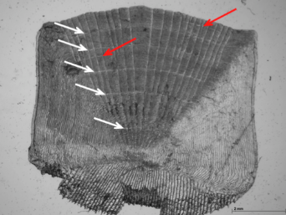
tblFish
fish_UID | fish_setUID | fish_sppUID | fish_length | fish_weight | fish_age | a1 | a2 | a3 | a4 | edge
1 | 1 | 1 | 210 | 254 | 4 | 178 | 223 | 381 | 413 | 413
2 | 1 | 1 | 243 | 222 | 4 | 145 | 242 | 335 | 481 | 490
3 | 2 | 1 | 135 | 86 | 2 | 195 | 284 |  |  | 292
4 | 3 | 2 | 142
5 | 4 | 3 | 138
6 | 5 | 3 | 179
7 | 6 | 1 | 198 | 168 | 3 | 188 | 254 | 365 |  | 365
8 | 7 | 4 | 854 | 355 | 4 | 113 | 241 | 384 | 476 | 484
9 | 8 | 4 | 686 | 321 | 3 | 105 | 289 | 349 |  | 349
10 | 9 | 5 | 312 | 211 |  |  |  |  |  | 230

Slide 106
tblFish
fish_UID | fish_setUID | fish_sppUID | fish_length | fish_weight | fish_age | fish_edge
1 | 1 | 1 | 210 | 254 | 4 | 413
2 | 1 | 1 | 243 | 222 | 4 | 490
3 | 2 | 1 | 135 | 86 | 2 | 292
4 | 3 | 2 | 142
5 | 4 | 3 | 138
6 | 5 | 3 | 179
7 | 6 | 1 | 198 | 168 | 3 | 365
8 | 7 | 4 | 854 | 355 | 4 | 484
9 | 8 | 4 | 686 | 321 | 3 | 349
10 | 9 | 5 | 312 | 211 |  | 230
 | fish_setUID | fish_sppUID | fish_length | fish_weight | fish_age | a1 | a2 | a3 | a4 | edge
 | 1 | 1 | 210 | 254 | 4 | 178 | 223 | 381 | 413 | 413
 | 1 | 1 | 243 | 222 | 4 | 145 | 242 | 335 | 481 | 490
 | 2 | 1 | 135 | 86 | 2 | 195 | 284 |  |  | 292
 | 3 | 2 | 142
 | 4 | 3 | 138
 | 5 | 3 | 179
 | 6 | 1 | 198 | 168 | 3 | 188 | 254 | 365 |  | 365
 | 7 | 4 | 854 | 355 | 4 | 113 | 241 | 384 | 476 | 484
 | 8 | 4 | 686 | 321 | 3 | 105 | 289 | 349 |  | 349
 | 9 | 5 | 312 | 211 |  |  |  |  |  | 230
tblAge
age_UID | age_fishUID | age_age | age_annulus
1 | 1 | 1 | 178
2 | 1 | 2 | 223
3 | 1 | 3 | 381
4 | 1 | 4 | 413
5 | 2 | 1 | 145
6 | 2 | 2 | 242
7 | 2 | 3 | 335
8 | 2 | 4 | 481
9 | 3 | 1 | 195
10 | 3 | 2 | 284
11 | 7 | 1 | 188
12 | 7 | 2 | 254
13 | 7 | 3 | 365
14 | 8 | 1 | 113
15 | 8 | 2 | 241
16 | 8 | 3 | 384
17 | 8 | 4 | 476
18 | 9 | 1 | 105
19 | 9 | 2 | 289
20 | 9 | 3 | 349

Slide 107
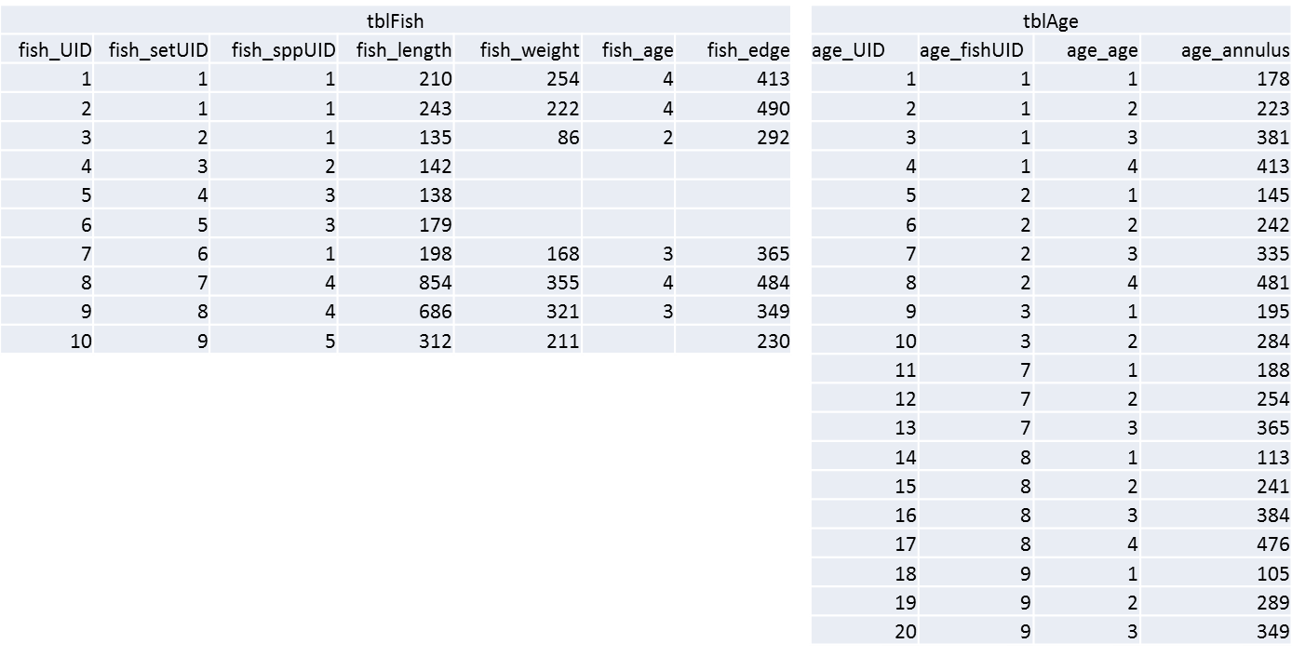
SELECT tblFish.fish_UID, tblAge.age_age, [Intercept]+([fish_length]-[Intercept])*([age_annulus]/[fish_edge]) AS LAA
FROM (tblSpecies INNER JOIN tblFish ON tblSpecies.spp_UID = tblFish.fish_sppUID) INNER JOIN tblAge ON tblFish.fish_UID = tblAge.age_fishUID;

Slide 108
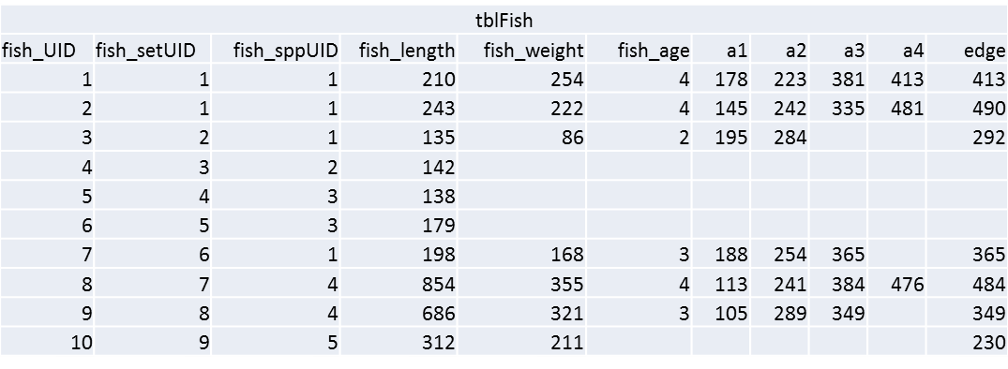
SELECT tblFish.fish_UID, tblAge.age_age, [Intercept]+([fish_length]-[Intercept])*([age_annulus]/[fish_edge]) AS LAA
FROM (tblSpecies INNER JOIN tblFish ON tblSpecies.spp_UID = tblFish.fish_sppUID) INNER JOIN tblAge ON tblFish.fish_UID = tblAge.age_fishUID;
SELECT tblFish.fish_UID, tblAge.age_age, [Intercept]+([fish_length]-[Intercept])*([age_annulus1]/[fish_edge]) AS LAA1, [Intercept]+([fish_length]-[Intercept])*([age_annulus2]/[fish_edge]) AS LAA2, [Intercept]+([fish_length]-[Intercept])*([age_annulus3]/[fish_edge]) AS LAA3, [Intercept]+([fish_length]-[Intercept])*([age_annulus4]/[fish_edge]) AS LAA4 FROM (tblSpecies INNER JOIN tblFish ON tblSpecies.spp_UID = tblFish.fish_sppUID) INNER JOIN tblAge ON tblFish.fish_UID = tblAge.age_fishUID;

Slide 109
SELECT tblFish.fish_UID, tblAge.age_age, [Intercept]+([fish_length]-[Intercept])*([age_annulus]/[fish_edge]) AS LAA
FROM (tblSpecies INNER JOIN tblFish ON tblSpecies.spp_UID = tblFish.fish_sppUID) INNER JOIN tblAge ON tblFish.fish_UID = tblAge.age_fishUID;
SELECT tblFish.fish_UID, tblAge.age_age, [Intercept]+([fish_length]-[Intercept])*([age_annulus1]/[fish_edge]) AS LAA1, [Intercept]+([fish_length]-[Intercept])*([age_annulus2]/[fish_edge]) AS LAA2, [Intercept]+([fish_length]-[Intercept])*([age_annulus3]/[fish_edge]) AS LAA3, [Intercept]+([fish_length]-[Intercept])*([age_annulus4]/[fish_edge]) AS LAA4, [Intercept]+([fish_length]-[Intercept])*([age_annulus5]/[fish_edge]) AS LAA5, [Intercept]+([fish_length]-[Intercept])*([age_annulus6]/[fish_edge]) AS LAA6, [Intercept]+([fish_length]-[Intercept])*([age_annulus7]/[fish_edge]) AS LAA7, [Intercept]+([fish_length]-[Intercept])*([age_annulus8]/[fish_edge]) AS LAA8, [Intercept]+([fish_length]-[Intercept])*([age_annulus9]/[fish_edge]) AS LAA9, [Intercept]+([fish_length]-[Intercept])*([age_annulus10]/[fish_edge]) AS LAA10 FROM (tblSpecies INNER JOIN tblFish ON tblSpecies.spp_UID = tblFish.fish_sppUID) INNER JOIN tblAge ON tblFish.fish_UID = tblAge.age_fishUID;

Slide 110
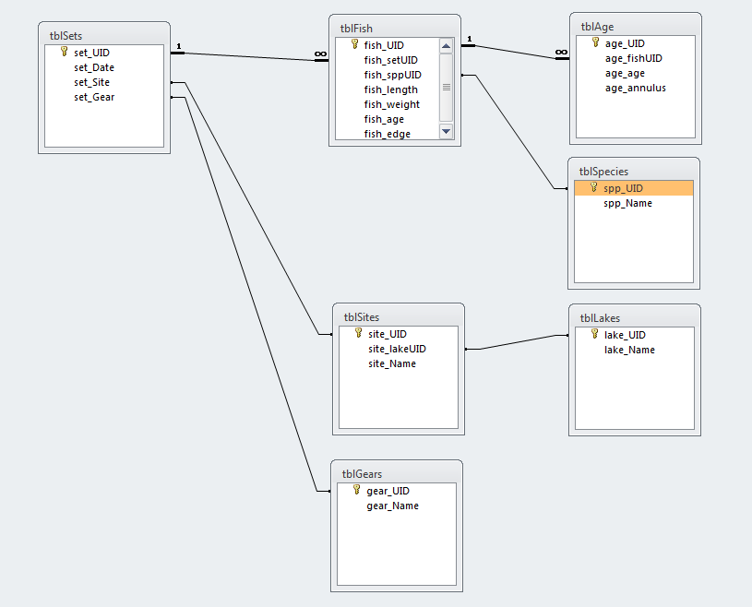

Slide 113
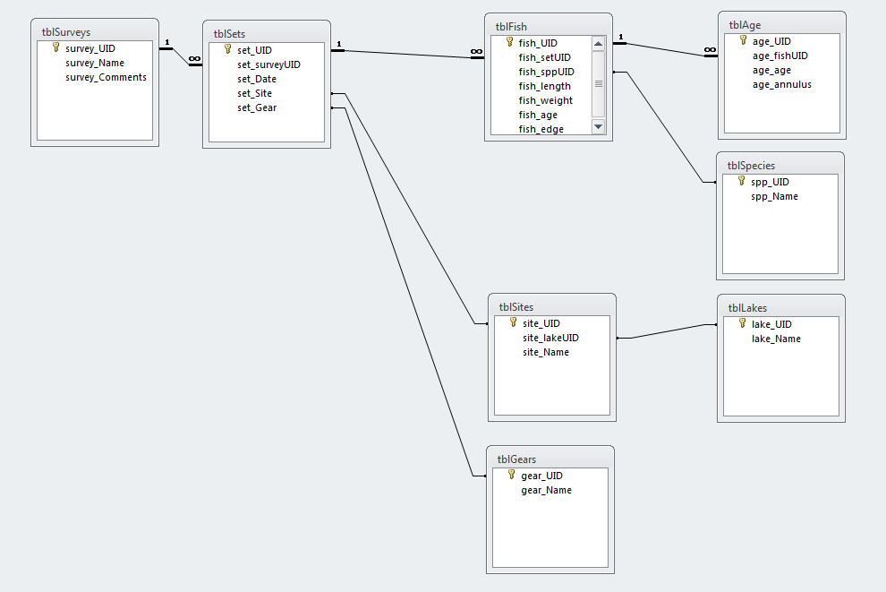

Slide 114


Slide 115
Two More Steps:
Label Required Fields
Label Data Types

Slide 116
Data types
Text fields
text vs memo
text vs number
empty string vs null
Date/time fields
Boolean/bit fields
Integer/Double/Decimal
Specialty Fields

Slide 117
Data type | Description | Storage
Text | Use for text or combinations of text and numbers. 255 characters maximum
Memo | Memo is used for larger amounts of text. Stores up to 65,536 characters. Note: You cannot sort a memo field. However, they are searchable
Byte | Allows whole numbers from 0 to 255 | 1 byte
Integer | Allows whole numbers between -32,768 and 32,767 | 2 bytes
Long | Allows whole numbers between -2,147,483,648 and 2,147,483,647 | 4 bytes
Single | Single precision floating-point. Will handle most decimals | 4 bytes
Double | Double precision floating-point. Will handle most decimals | 8 bytes
Currency | Use for currency. Holds up to 15 digits of whole dollars, plus 4 decimal places. Tip:You can choose which country's currency to use | 8 bytes
AutoNumber | AutoNumber fields automatically give each record its own number, usually starting at 1 | 4 bytes
Date/Time | Use for dates and times | 8 bytes
Yes/No | A logical field can be displayed as Yes/No, True/False, or On/Off. In code, use the constants True and False (equivalent to -1 and 0). Note: Null values are not allowed in Yes/No fields | 1 bit
Ole Object | Can store pictures, audio, video, or other BLOBs (Binary Large OBjects) | up to 1GB
Hyperlink | Contain links to other files, including web pages

Slide 118


Slide 119


Slide 120
To Do
Create Lookup Tables To Remove Text
Split Out Sets Of Fields That Repeat Down Columns
Transpose columns to rows where possible
Goals
Each row represents one and only one piece of meaningful data
Each piece of data is in only one place
No data is in field headers
In production, you can add rows and not columns

Slide 121
Performance
Primary Keys
Indexes
Stored Procedures/Views

Slide 122
I’ve Learned So Much From My Mistakes…
I’m Thinking Of Making A Few More
Notes:
We’ve all made mistakes
Share one of mine.

Slide 123

Lets Design A Database!

Slide 124

Any Problems?

Slide 125


Slide 126


Slide 127


Slide 128
Queries and SQL
Notes:
Use access to show how to design a database
Good design means
simpler queries
better performance
less data entry
easier to add data fields without breaking backwards compatibility
Think of records as an “entity”…and then “sets” of entities”

Slide 129
CRUD Queries
Create
Update
Delete

Slide 130

Select A From B Where C
Select set_date From tblSets Where set_gear = 1

Slide 131



Keith Hurley
keith.hurley@Nebraska.gov

Slide 132
Data teams know they’re sitting on valuable insights but can’t sell them. They say decision makers misunderstand or oversimplify their analysis and expect them to do magic, to provide the right answers to all their questions. Executives, meanwhile, complain about how much money they invest in data science operations that don’t provide the guidance they hoped for. They don’t see tangible results because the results aren’t communicated in their language.
--Data Science and the Art of Persuasion (Harvard Business Review, 2019)

Slide 133
Consider that 105 years ago, before coding and computers, Willard Brinton began his landmark book Graphic Methods for Presenting Facts by describing the last-mile problem: “Time after time it happens that some ignorant or presumptuous member of a committee or a board of directors will upset the carefully-thought-out plan of a man who knows the facts, simply because the man with the facts cannot present his facts readily enough to overcome the opposition….As the cathedral is to its foundation so is an effective presentation of facts to the data.”
--Data Science and the Art of Persuasion (Harvard Business Review, 2019)

Slide 134
…organizations have been hiring the most technically oriented people they can find, ignoring their ability or desire (or lack thereof) to communicate with a lay audience.
That would be fine if those organizations also hired other people to close the gap—but they don’t. They still expect data scientists to wrangle data, analyze it in the context of knowing the business and its strategy, make charts, and present them to a lay audience. That’s unreasonable. That’s unicorn stuff.
-- Data Science and the Art of Persuasion
(Harvard Business Review, 2019)

Slide 135
Chart Wizard, Microsoft’s innovation in Excel, introduced “click and viz” for the rest of us, fully cleaving the two worlds. Suddenly anyone could instantly create a chart along with overwrought variations on it that made bars three-dimensional or turned a pie into a doughnut. The profoundness of this shift can’t be overstated. ………
Designers—draftspeople—were devalued and eventually fell out of data analysis. Visualization became the job of those who managed data, most of whom were neither trained to visualize nor inclined to learn. The speed and convenience of pasting a Chart Wizard graphic into a presentation prevailed over slower, more resource-intensive, design-driven visuals, even if the latter were demonstrably more effective.
--Data Science and the Art of Persuasion (Harvard Business Review, 2019)

